Slide 1
Resource Allocation in Wireless Cellular Networks
M. Rasti
Amirkabir University of Technology

Slide 2
Course Syllabus
I- Basics of Wireless Networks
1- Introduction of Wireless Networks and Radio Resources
2- Categories of Wireless Networks and Taxonomy of Hot Topics Research Areas on Resource Allocation in Wireless Networks
II- Techniques for Modeling and Analysis of Radio Resource Allocation in Wireless Networks
3- Convex Optimization
4- Game Theory
III- Physical Layer Resource Allocation in Wireless Networks
5- General System Model and Preliminary Concepts
6- Power Control in Wireless Cellular Networks
7- Joint Power and Admission Control in Cellular Wireless Networks
8- Cell Association in Cellular Networks
9- Application of Game Theory in Physical Layer Resource Allocation in Wireless Networks
10- Joint Power and Admission Control in Cognitive Radio Network

Slide 3
Lecture 4 Outline:
General System Model and Preliminary Concepts
General System Model
SINR Feasibility in Interference Limited Wireless Networks

Slide 4
A General System Model
The wireless network as a collection of interfering radio link in a single channel
Wireless network
Cellular wireless network
Ad hoc wireless network
Each link corresponds to a single-hop radio transmission from a transmitter node to an intended receiver node
In the cellular network paradigm, a link corresponds to an up-stream or a down-stream transmission between a mobile and its assigned base-station.
In the ad hoc network paradigm, a link corresponds to single-hop transmission between mobile nodes

Slide 5
System Model and Notations
Channel
In FDMA systems, the channels are non-overlaping frequency bands
In CDMA, the whole spectrum is viewed as a single channel
Interference
In a non-orthogonal uplink , such as CDMA, transmit power from all links appear as interference
In a orthogonal uplink , such as OFDMA,
transmit power from a link terminating on the same BS are orthogonal, and dose not contribute interference to one another
transmit power from a link terminating on a given BS appears as interference only to the links on different BS

Slide 6
Single-cell System Model
In order to state fundamental concept and algorithm, we consider an uplink single-cell CDMA wireless network
After stating the basic concepts and power control algorithms, we will consider multi-cell wireless networks

Slide 7
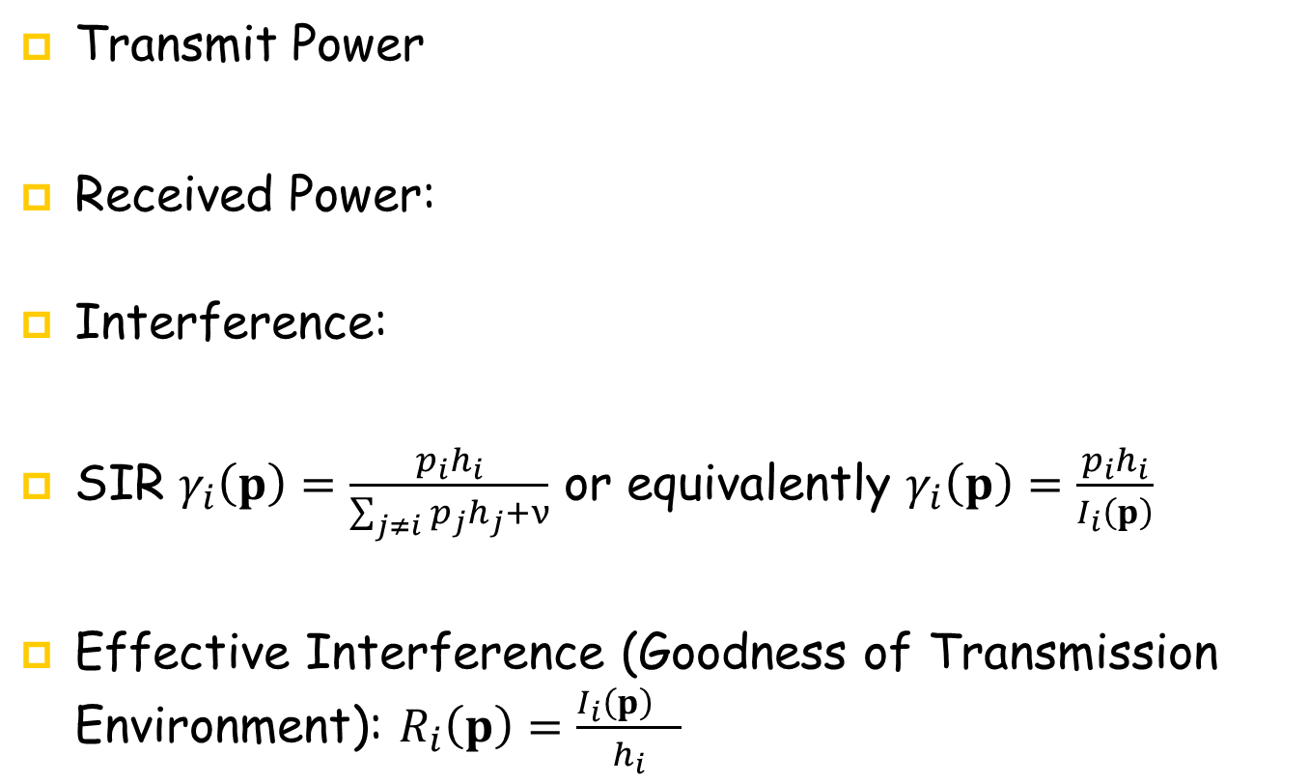
Single-Cell System Model and Notations: Uplink Case
Transmit Power
Received Power:
Interference:
SIR $γ_{i}\left(p\right)=\frac{p_{i}h_{i}}{\sum_{j≠i}{p_{j}h_{j}+ν}}$ or equivalently $γ_{i}\left(p\right)=\frac{p_{i}h_{i}}{I_{i}\left(p\right)}$
Effective Interference (Goodness of Transmission Environment): $R_{i}\left(p\right)=\frac{{I_{i}\left(p\right)}_{}}{h_{i}}$

Slide 8
SIR Feasibility in Single-Cell Model
We wish to derive a relation stating a transmit power of a user in terms of SIRs of users in a single-cell
Derive it for two users!
Find the transmit power for two users in terms of their SIRs

Slide 9


SIR Feasibility in A Single-Cell Model
There is a one-to-one relation between a transmit power vector and
the SIR vector
Total received power plus noise power at the base-station is
$$p_{i}=\frac{γ_{i}}{h_{i}(γ_{i}+1) }×\frac{v}{1−\sum_{k}{\frac{γ_{k}}{γ_{k}+1 }}}$$
$$\sum_{k}{h_{k}p_{k}+ν}=\frac{v}{1−\sum_{k}{\frac{γ_{k}}{γ_{k}+1 }}}$$

Slide 10
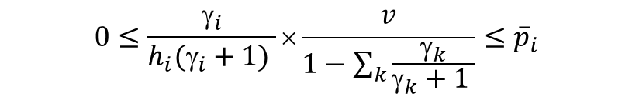
SIR Feasibility in a Single-Cell Model
Constraints
Technological and regulatory limitations (e.g., maximum received or transmit power)
Individual users’ requirements (e.g., two users’ received power at BS need to be the same, …)
Feasibility constraint (most complicated constraint [1], e.g., SIR feasibility)
SIR feasibility: The SIR vector is feasible if
$$0≤\frac{γ_{i}}{h_{i}(γ_{i}+1) }×\frac{v}{1−\sum_{k}{\frac{γ_{k}}{γ_{k}+1 }}}≤{\overline{p}}_{i}$$

Slide 11
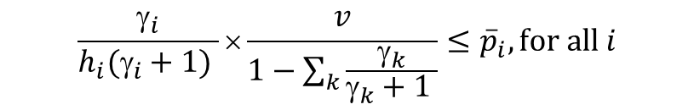
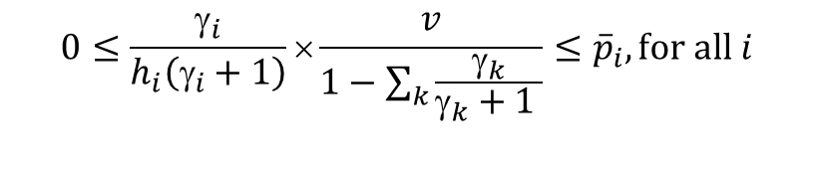
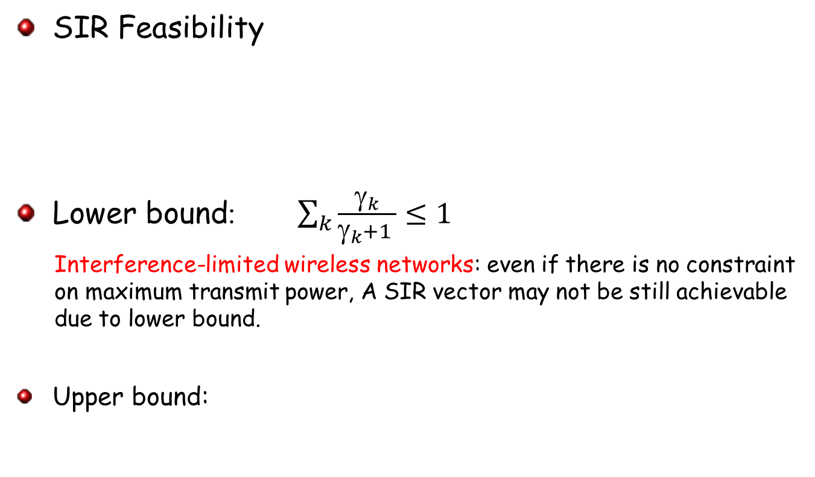
Interference Limited Wireless Networks
SIR Feasibility
Lower bound :$\sum_{k}{\frac{γ_{k}}{γ_{k}+1 }}≤1$
Interference-limited wireless networks: even if there is no constraint on maximum transmit power, A SIR vector may not be still achievable due to lower bound.
Upper bound:
$$0≤\frac{γ_{i}}{h_{i}\left(γ_{i}+1\right)}×\frac{v}{1−\sum_{k}{\frac{γ_{k}}{γ_{k}+1 }}}≤{\overline{p}}_{i},for all i$$
$$\frac{γ_{i}}{h_{i}(γ_{i}+1) }×\frac{v}{1−\sum_{k}{\frac{γ_{k}}{γ_{k}+1 }}}≤{\overline{p}}_{i},for all i$$

Slide 12
General System Model
General Multicell
M users (mobile station (MS)) establish links to N base station
Each user is served by one of the N BSs

Slide 13
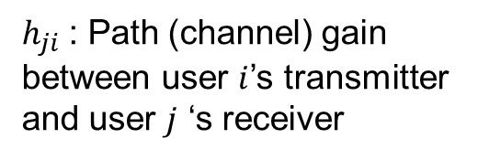
Multicell Networks (Uplink)
$h_{ji}$: Path (channel) gain between user $i$’s transmitter and user $j$ ‘s receiver
h_{ii}
i
h_{i1}
h_{j1}
h_{ji}
1
h_{i2}
h_{j2}
2
h_{ij}
h_{jj}
j

Slide 14
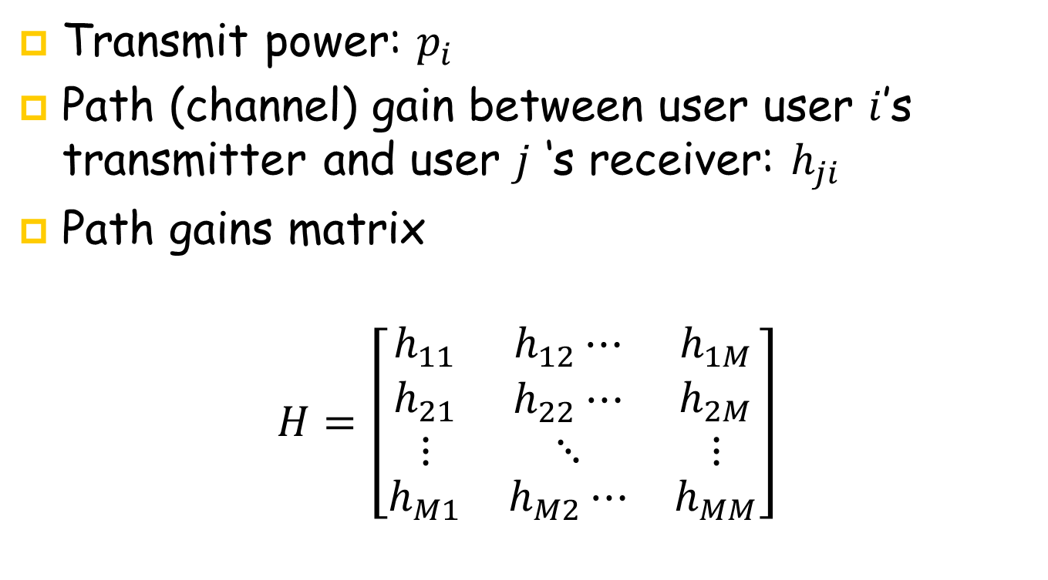
Multicell System Model
Transmit power: $p_{i}$
Path (channel) gain between user user $i$’s transmitter and user $j$ ‘s receiver: $h_{ji}$
Path gains matrix
$$H=\left[\begin{matrix}h_{11} & h_{12}⋯ & h_{1M} \\ \begin{aligned}h_{21} \\ ⋮\end{aligned} & \begin{aligned}h_{22}⋯ \\ ⋱\end{aligned} & \begin{aligned}h_{2M} \\ ⋮\end{aligned} \\ h_{M1} & h_{M2}⋯ & h_{MM}\end{matrix}\right]$$

Slide 15
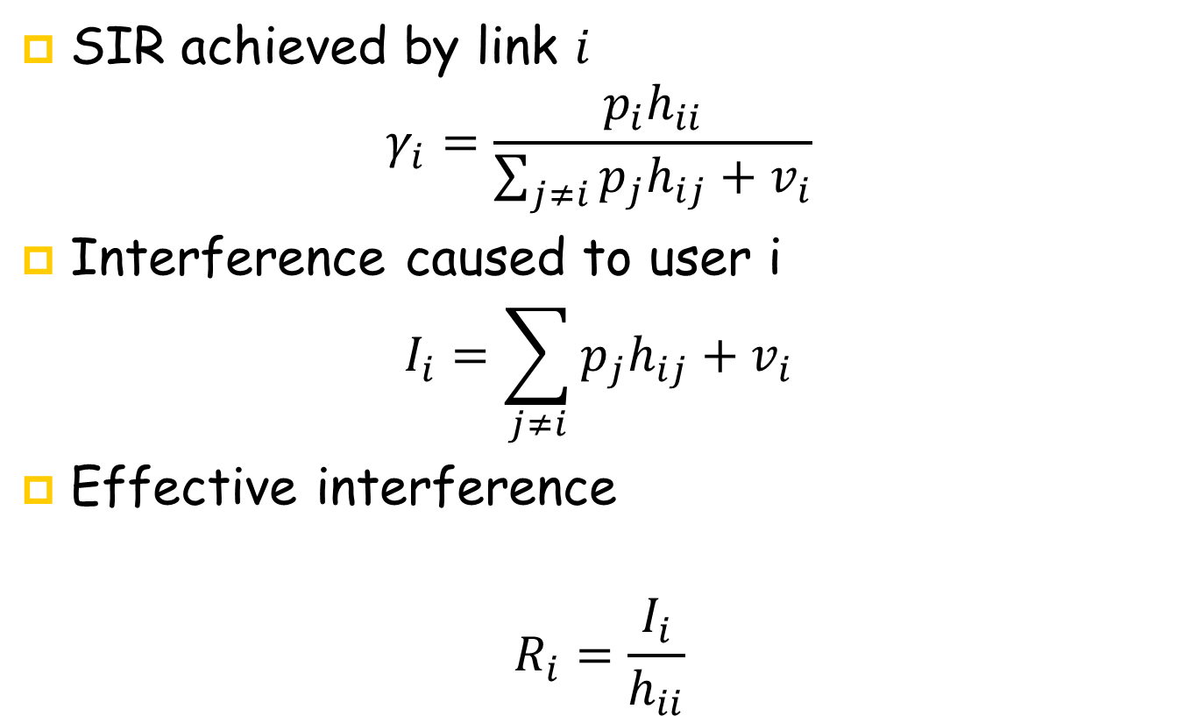
Multicell System Model
SIR achieved by link $i$
$$γ_{i}=\frac{p_{i}h_{ii}}{\sum_{j≠i}{p_{j}h_{ij}+v_{i}}}$$
Interference caused to user i
$$I_{i}=\sum_{j≠i}{p_{j}h_{ij}+v_{i}}$$
Effective interference
$$R_{i}=\frac{I_{i}}{h_{ii}}$$

Slide 16
SIR Feasibility in in Multi-Cell Model
The SIR vector is is called feasible if there exist a positive power vector that satisfies the SIR vector.

Slide 17
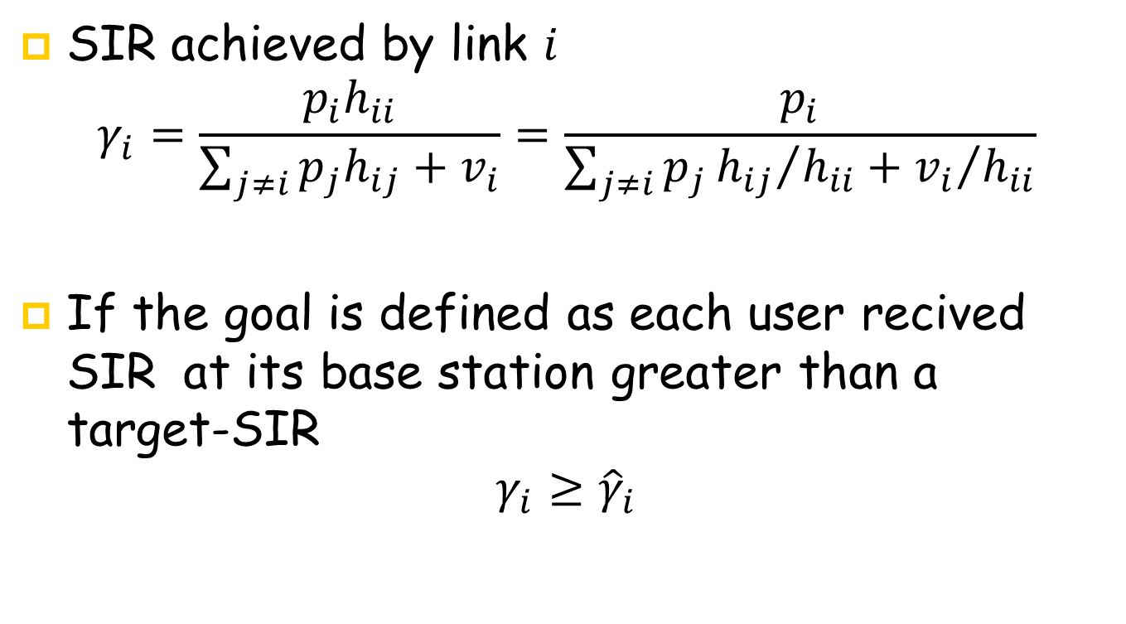
Target-SIR
SIR achieved by link $i$
$$γ_{i}=\frac{p_{i}h_{ii}}{\sum_{j≠i}{p_{j}h_{ij}+v_{i}}}=\frac{p_{i}}{\sum_{j≠i}{p_{j}{h_{ij}}/{h_{ii}}+{v_{i}}/{h_{ii}}}}$$
If the goal is defined as each user recived SIR at its base station greater than a target-SIR
$${γ_{i}≥\hat{γ}}_{i}$$

Slide 18
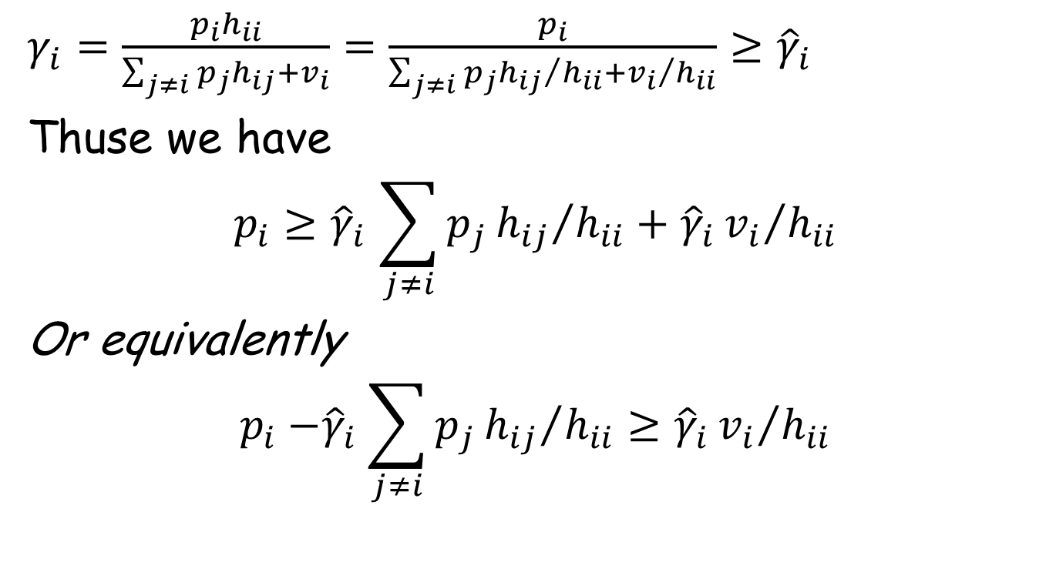
Target-SIR
$γ_{i}=\frac{p_{i}h_{ii}}{\sum_{j≠i}{p_{j}h_{ij}+v_{i}}}=\frac{p_{i}}{\sum_{j≠i}{p_{j}{h_{ij}}/{h_{ii}}+{v_{i}}/{h_{ii}}}}$ ${≥\hat{γ}}_{i}$
Thuse we have
$$p_{i}{≥\hat{γ}}_{i}\sum_{j≠i}{p_{j}{h_{ij}}/{h_{ii}}+{\hat{γ}}_{i}{v_{i}}/{h_{ii}}}$$
Or equivalently
$$p_{i}{−\hat{γ}}_{i}\sum_{j≠i}{p_{j}{h_{ij}}/{h_{ii}}≥{\hat{γ}}_{i}{v_{i}}/{h_{ii}}}$$

Slide 19
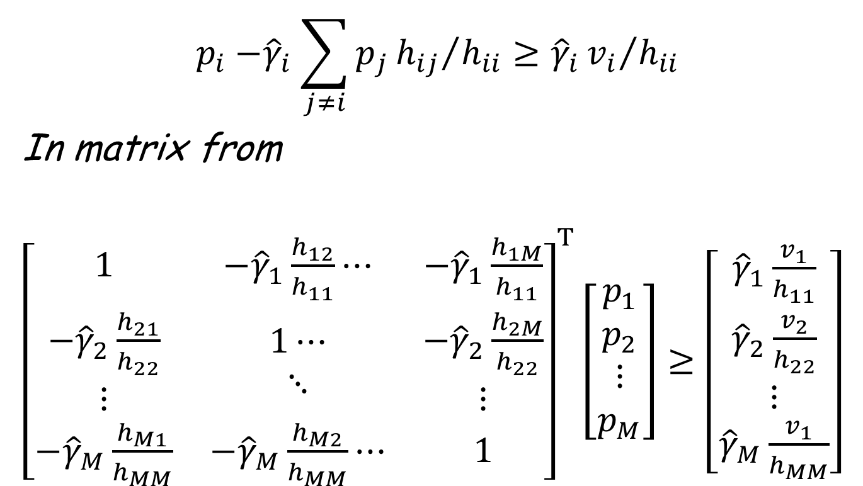
Required Transmit Power to Reach the Target-SIRs Vector
$$p_{i}{−\hat{γ}}_{i}\sum_{j≠i}{p_{j}{h_{ij}}/{h_{ii}}≥{\hat{γ}}_{i}{v_{i}}/{h_{ii}}}$$
In matrix from
${\left[\begin{matrix}1 & {−\hat{γ}}_{1}\frac{h_{12}}{h_{11}}⋯ & −{\hat{γ}}_{1}\frac{h_{1M}}{h_{11}} \\ \begin{aligned}{−\hat{γ}}_{2}\frac{h_{21}}{h_{22}} \\ ⋮\end{aligned} & \begin{aligned}1⋯ \\ ⋱\end{aligned} & \begin{aligned}{−\hat{γ}}_{2}\frac{h_{2M}}{h_{22}} \\ ⋮\end{aligned} \\ {−\hat{γ}}_{M}\frac{h_{M1}}{h_{MM}} & {−\hat{γ}}_{M}\frac{h_{M2}}{h_{MM}}⋯ & 1\end{matrix}\right]}^{T}\left[\begin{aligned}p_{1} \\ p_{2} \\ ⋮ \\ p_{M}\end{aligned}\right]≥$ $\left[\begin{aligned}{\hat{γ}}_{1}\frac{v_{1}}{h_{11}} \\ {\hat{γ}}_{2}\frac{v_{2}}{h_{22}} \\ ⋮ \\ {\hat{γ}}_{M}\frac{v_{1}}{h_{MM}}\end{aligned}\right]$

Slide 20
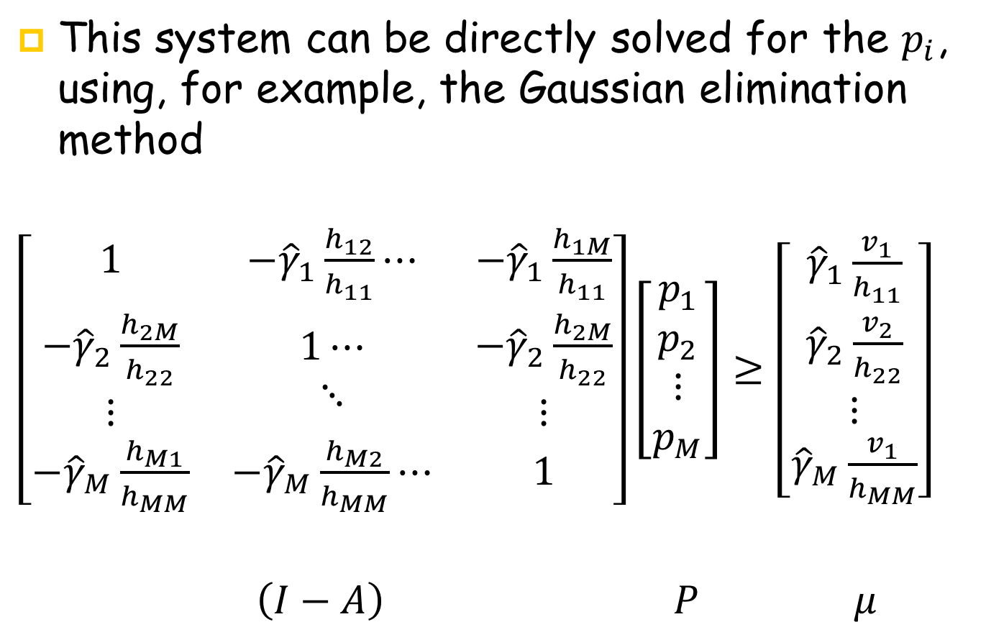
Required Transmit Power to Reach the Target-SIRs Vector
This system can be directly solved for the $p_{i}$, using, for example, the Gaussian elimination method
$\left[\begin{matrix}1 & {−\hat{γ}}_{1}\frac{h_{12}}{h_{11}}⋯ & −{\hat{γ}}_{1}\frac{h_{1M}}{h_{11}} \\ \begin{aligned}{−\hat{γ}}_{2}\frac{h_{2M}}{h_{22}} \\ ⋮\end{aligned} & \begin{aligned}1⋯ \\ ⋱\end{aligned} & \begin{aligned}{−\hat{γ}}_{2}\frac{h_{2M}}{h_{22}} \\ ⋮\end{aligned} \\ {−\hat{γ}}_{M}\frac{h_{M1}}{h_{MM}} & {−\hat{γ}}_{M}\frac{h_{M2}}{h_{MM}}⋯ & 1\end{matrix}\right]\left[\begin{aligned}p_{1} \\ p_{2} \\ ⋮ \\ p_{M}\end{aligned}\right]≥$ $\left[\begin{aligned}{\hat{γ}}_{1}\frac{v_{1}}{h_{11}} \\ {\hat{γ}}_{2}\frac{v_{2}}{h_{22}} \\ ⋮ \\ {\hat{γ}}_{M}\frac{v_{1}}{h_{MM}}\end{aligned}\right]$
$\left(I−A\right)$ $P$ $μ$

Slide 21
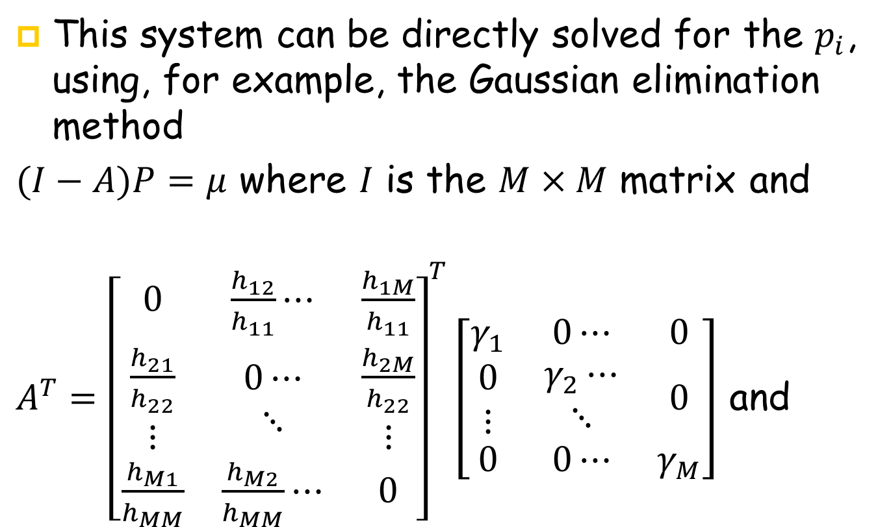
Required Transmit Power to Reach the Target-SIRs Vector
This system can be directly solved for the $p_{i}$, using, for example, the Gaussian elimination method
$(I−A)P=μ$ where $I$ is the $M×M$ matrix and
$A^{T}={\left[\begin{matrix}0 & \frac{h_{12}}{h_{11}}⋯ & \frac{h_{1M}}{h_{11}} \\ \begin{aligned}\frac{h_{21}}{h_{22}} \\ ⋮\end{aligned} & \begin{aligned}0⋯ \\ ⋱\end{aligned} & \begin{aligned}\frac{h_{2M}}{h_{22}} \\ ⋮\end{aligned} \\ \frac{h_{M1}}{h_{MM}} & \frac{h_{M2}}{h_{MM}}⋯ & 0\end{matrix}\right]}^{T}\left[\begin{matrix}γ_{1} & 0⋯ & 0 \\ \begin{aligned}0 \\ ⋮\end{aligned} & \begin{aligned}γ_{2}⋯ \\ ⋱\end{aligned} & 0 \\ 0 & 0⋯ & γ_{M}\end{matrix}\right]$ and

Slide 22

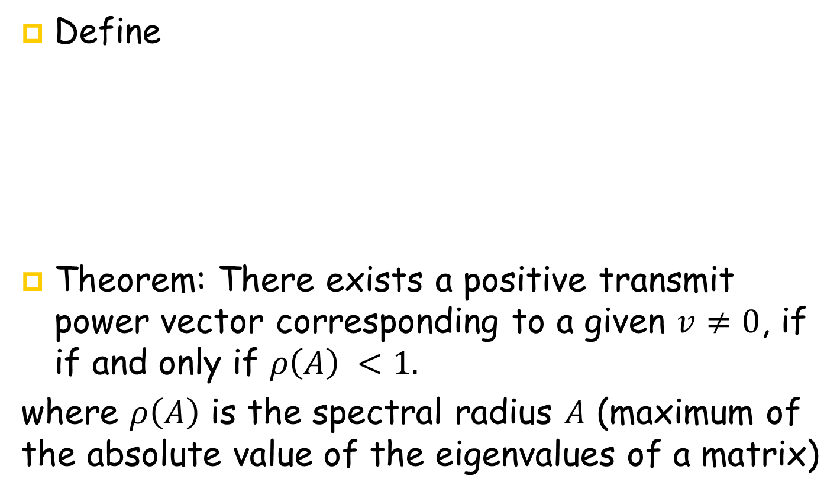
SIR feasibility in a general system model
Define
Theorem: There exists a positive transmit power vector corresponding to a given $v≠0$, if if and only if $ρ\left(A\right) <1.$
where $ρ\left(A\right)$ is the spectral radius $A$ (maximum of the absolute value of the eigenvalues of a matrix)
A$=\left[\begin{matrix}0 & \frac{h_{12}}{h_{11}}⋯ & \frac{h_{1M}}{h_{11}} \\ \begin{aligned}\frac{h_{21}}{h_{22}} \\ ⋮\end{aligned} & \begin{aligned}0⋯ \\ ⋱\end{aligned} & \begin{aligned}\frac{h_{2M}}{h_{22}} \\ ⋮\end{aligned} \\ \frac{h_{M1}}{h_{MM}} & \frac{h_{M2}}{h_{MM}}⋯ & 0\end{matrix}\right]\left[\begin{matrix}γ_{1} & 0⋯ & 0 \\ \begin{aligned}0 \\ ⋮\end{aligned} & \begin{aligned}γ_{2}⋯ \\ ⋱\end{aligned} & 0 \\ 0 & 0⋯ & γ_{M}\end{matrix}\right]$
Notes:
The mathematical expression of this idea is as follows: if A is a square matrix, a non-zero vector v is an eigenvector of A if there is a scalar λ (lambda) such that Av=\lamba V

